Slide 1



PREDICT
CUSTOMER
CHURN RATE
Bùi Thị Thanh Ngân

Slide 2





Bui Thi Thanh Ngan
Apply for Data Analyst Intern
0588314574
https://github.com/TNgan287
bingn285gmail.com
Go Vap District, Ho Chi Minh City

Slide 3

Customer Churn Prediction
Customer churn prediction is a critical aspect of business management, particularly for industries like telecommunications, internet service providers, pay TV companies, insurance firms, and alarm monitoring services. It involves understanding and addressing customer attrition, which refers to the loss of clients or customers.

Slide 4

Idea
To address customer churn, predictive analytics comes into play, churn prediction models to assess the likelihood of customers leaving. These models prioritize a small list of potential defectors, enabling businesses to concentrate their customer retention efforts on those who are most at risk of churning.

Slide 5




Process
Bussiness Understanding
Preprocessing
EDA and Build Model
Measurement

Slide 6

Bussiness Understanding
Detect and find out customers who are considering leaving by using machine learning ( Binary Classification)

Slide 7

Preprocessing
Have two file data:
churn-bigml-80.csv (Train)
churn-bigml-20.csv (Test)
Number of rows:
Number of rows data in Train set: 2666
Number of rows data in Test set: 667

Slide 8
Preprocessing
Preprocessing:
Check null data and remove
Scale the numeric feature data by using MinMaxScaler
Encode the categorical feature data

Slide 9
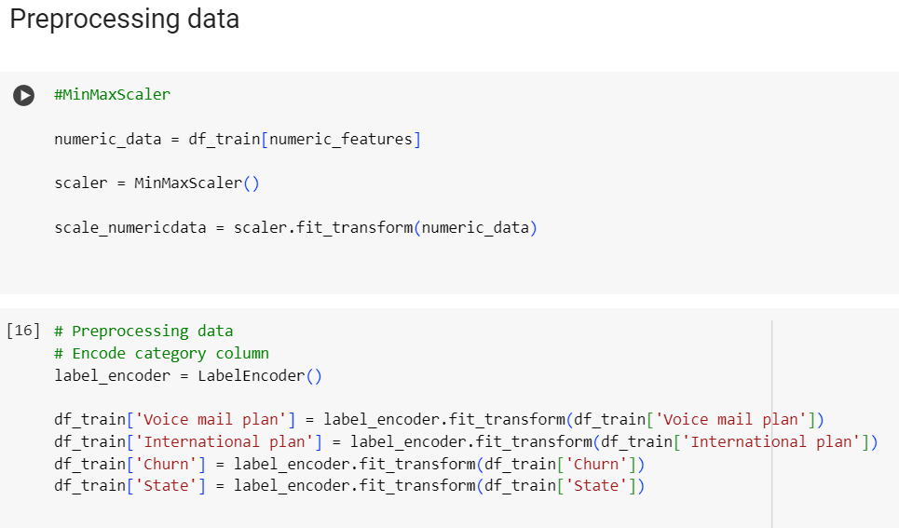
Preprocessing

Slide 10


Data Exploration
State
Account length
Area code
International plan
Voice mail plan
Number vmail messages
Total day minutes
Total day calls
Total day charge
Total eve minutes
Total eve calls
Total eve charge
Total night minutes
Total night calls
Total night charge
Total intl minutes
Total intl calls
Total intl charge
Customer service calls
Feature
Target feature
Churn
Because Churn just have 2 value True ot False
Binary Classification

Slide 11
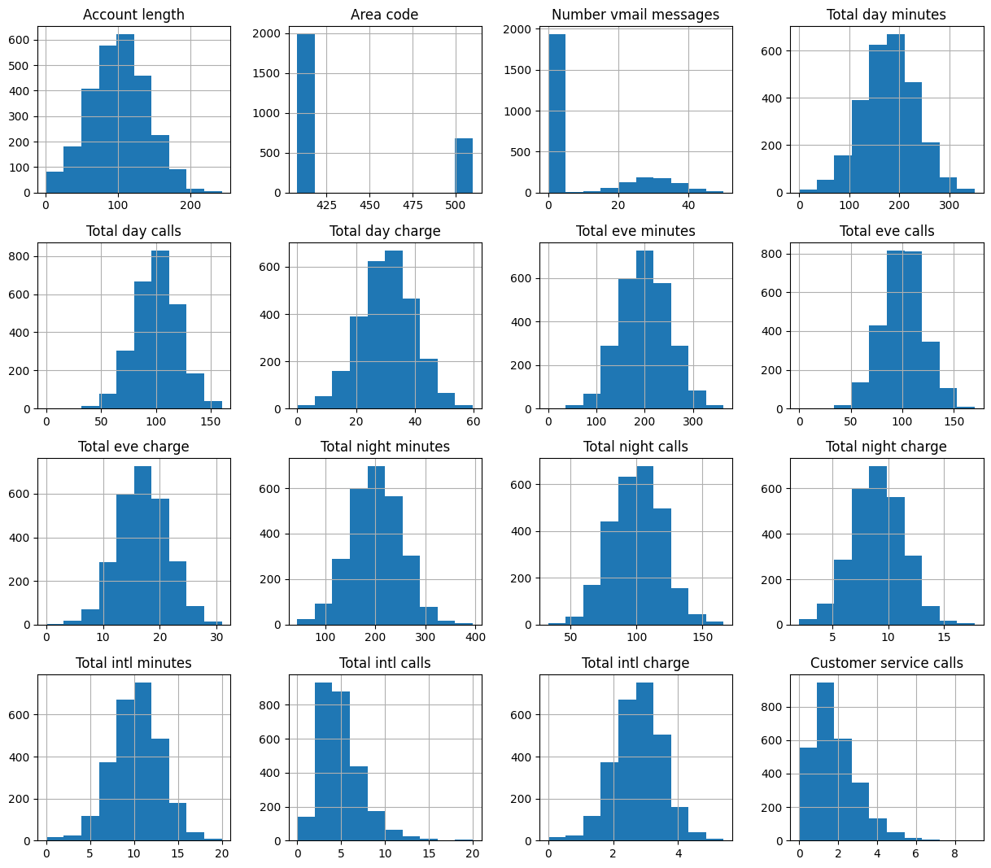
Data Exploration
Distribution of Variable

Slide 12
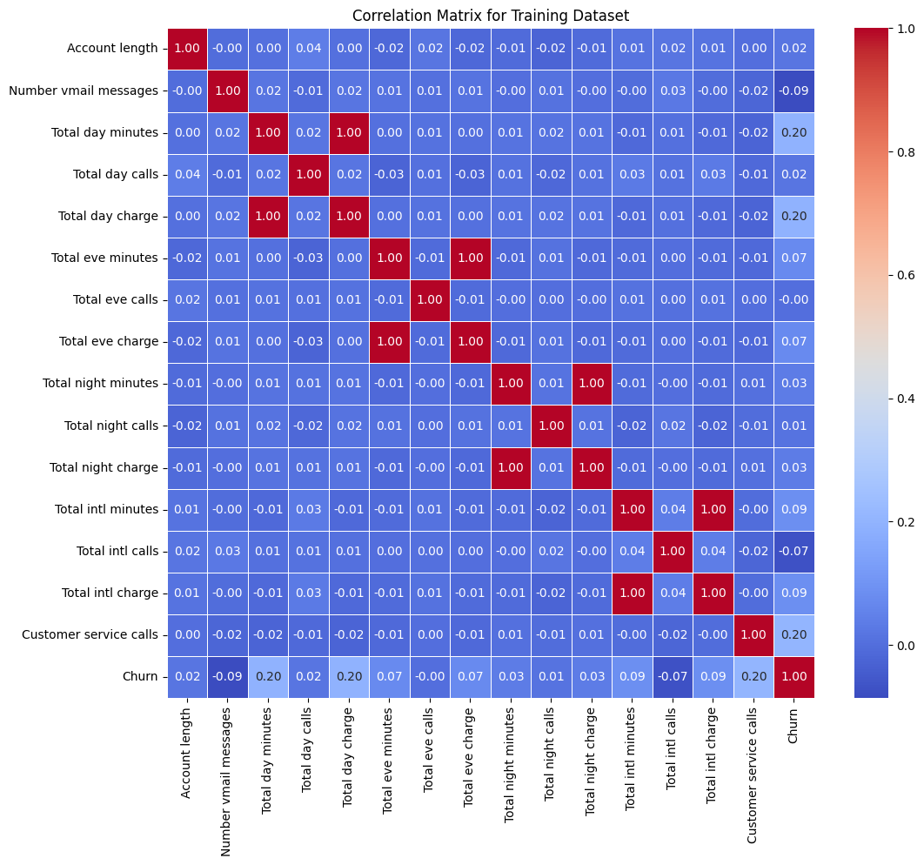
Data Exploration
Total day minutes and Customer Service Call are 2 feature have the strong correlation with Churn

Slide 13
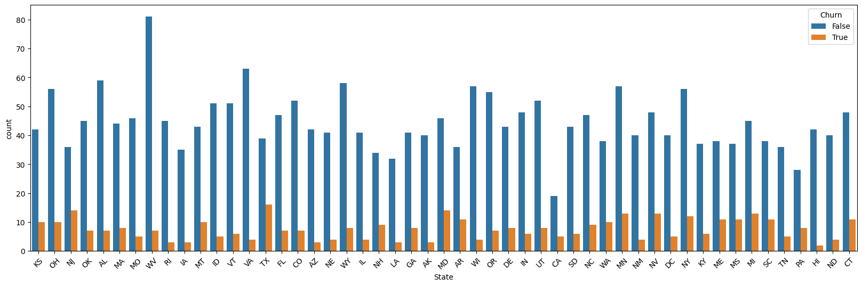
Data Exploration
In this chart I can see that the churn rate of customer in state TX, NJ, AK are top 3

Slide 14
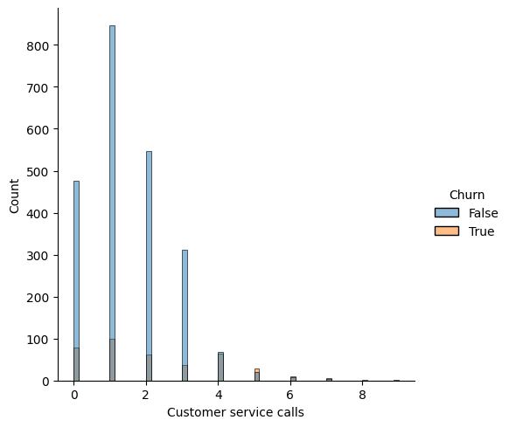
Data Exploration

Slide 15
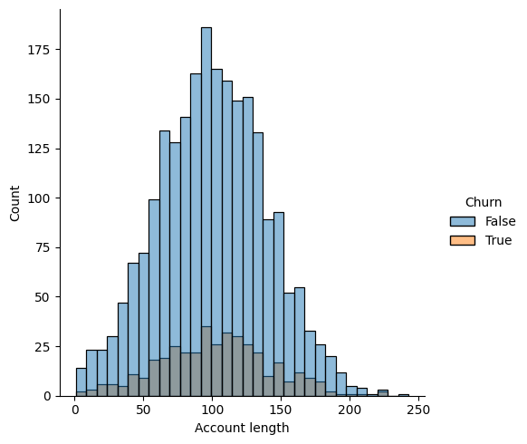
Data Exploration

Slide 16
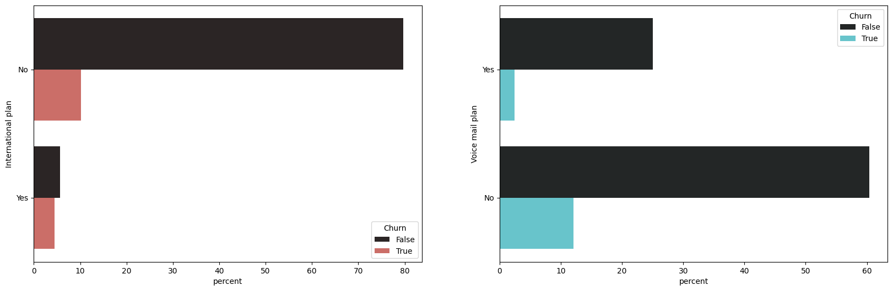
Data Exploration
Customer who have not Internaltional plan and Voice mail plan is higher churn

Slide 17
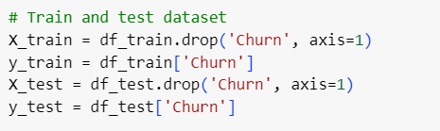
Train dataset and Test dataset

Slide 18
Build Models
Logistic Regression
Decision Tree
Random Forest
XGBoost

Slide 19


Build Models
I trained 4 models, which are proven to be effective, to predict churn
Logistic Regression
Decision Tree
Random Forest
XGBoost
Feature
Churn

Slide 20
Measurement
Precision
Recall
F1-score
Precision is the ratio of correctly predicted positive observations to the total predicted positives.
Recall is the ratio of correctly predicted positive observations to the all observations in the actual class.
F1-score is the harmonic mean of precision and recall.
True Positive
True Positive
Precision * Recall
2*
True Positive + False Positive
True Positive + False Negative
Precision + Recall

Slide 21
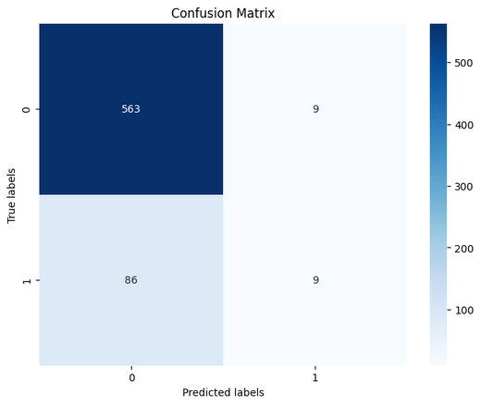
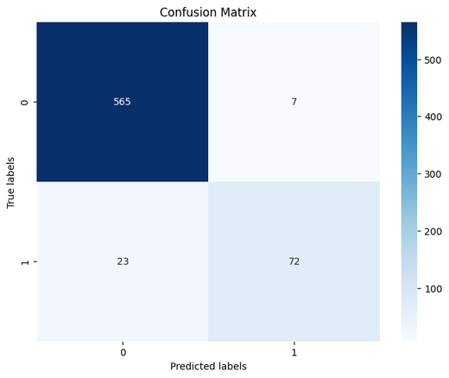

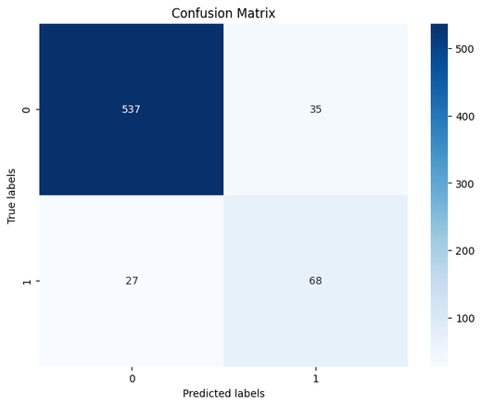
Confusion Matrix
Logistic Regression
XGBoost
Random Forest
Decision Tree

Slide 22
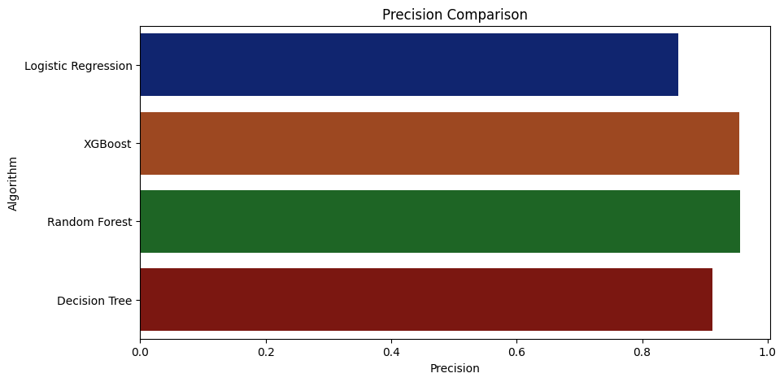
Measurement

Slide 23
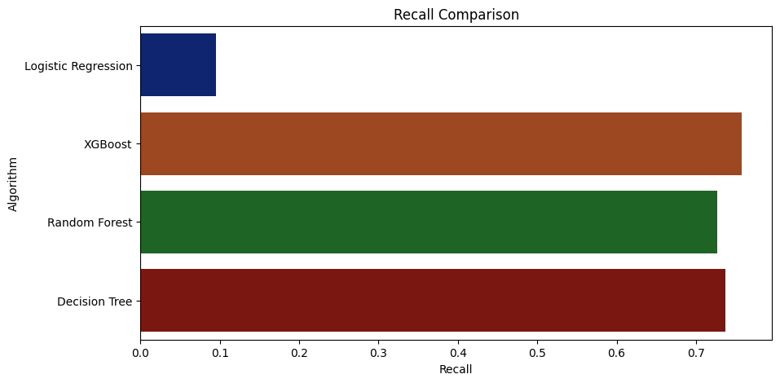
Measurement

Slide 24
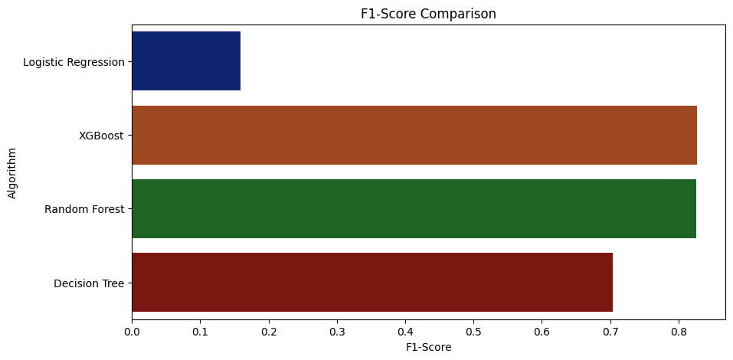
Measurement

Slide 25

Measurement
Recall focuses on predicting as many positive cases (churned customers) correctly as possible, without much concern for some false predictions (False Negatives).
Precision focuses on ensuring that the predicted positive cases (churned customers) are accurate, and minimizing false positives as much as possible.
So in this problem I use recall to choose the best model.

Slide 26


Conclusion
MODELS
RECALL
LOGISTIC REGRESSION
9%
DECISION TREE
72%
XGBOOST
76%
RANDOM FOREST
72%
XGBOOST is the best model because the recall is highest.

Slide 27

THANK YOU
FOR YOUR ATTENTION

